Slide 1
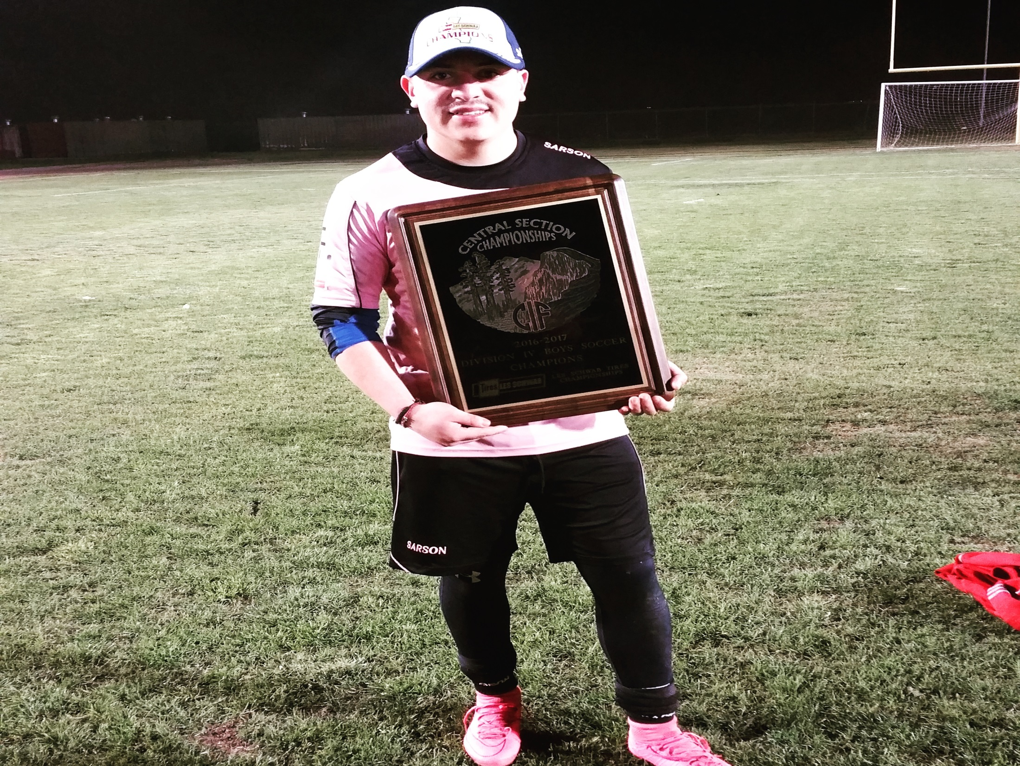
Felipe Lemus

Slide 2
About me
18 years old
Born in Mexico
Love soccer
2017 valley champ
Second oldest out of 4 children

Slide 3
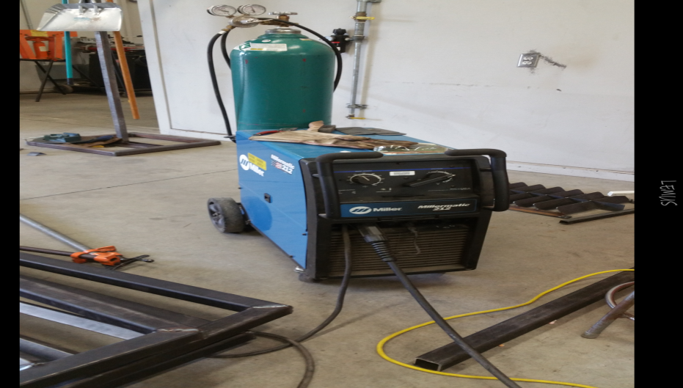
Clubs and Activities
4 year varsity soccer player
Ag mechanics 2 years
Farm ops 1 year
FFA

Slide 4
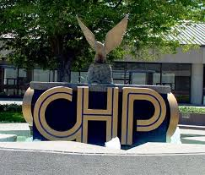
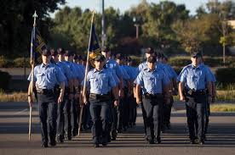
Job Shadow
Officer Lavender
Highway Patrol
Changes life style
Great experience

Slide 5
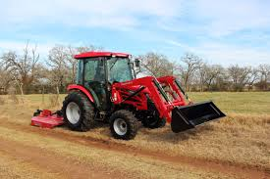
Path way
Agriculture
Farm Operations
Welding
Tractors
Enjoy

Slide 6
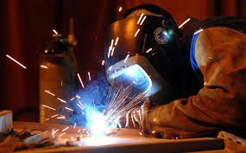
Post-High School Plans
COS
Certified Welder
North Carolina
Oil pump Welding
Start own business

Slide 7
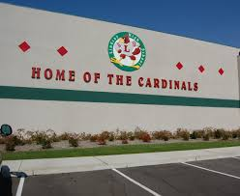
Leaving LHS
Going to miss my friends
Miss teachers
Miss playing soccer representing my school.
Leave very good memories
“Once a Cardinal always a Cardinal”

Slide 8
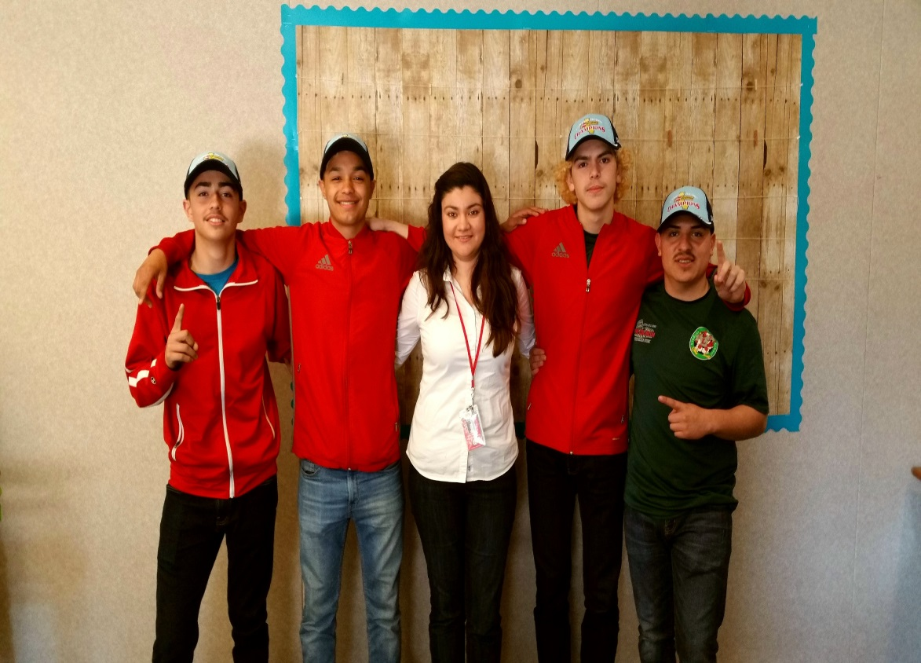
Influential Teacher
Mrs. Moreno
Great Advisor
Supportive
Problem Solver

Slide 9
Any Questions?
“The world is as big as you make it.” ~Douglas Johnson

